Slide 1

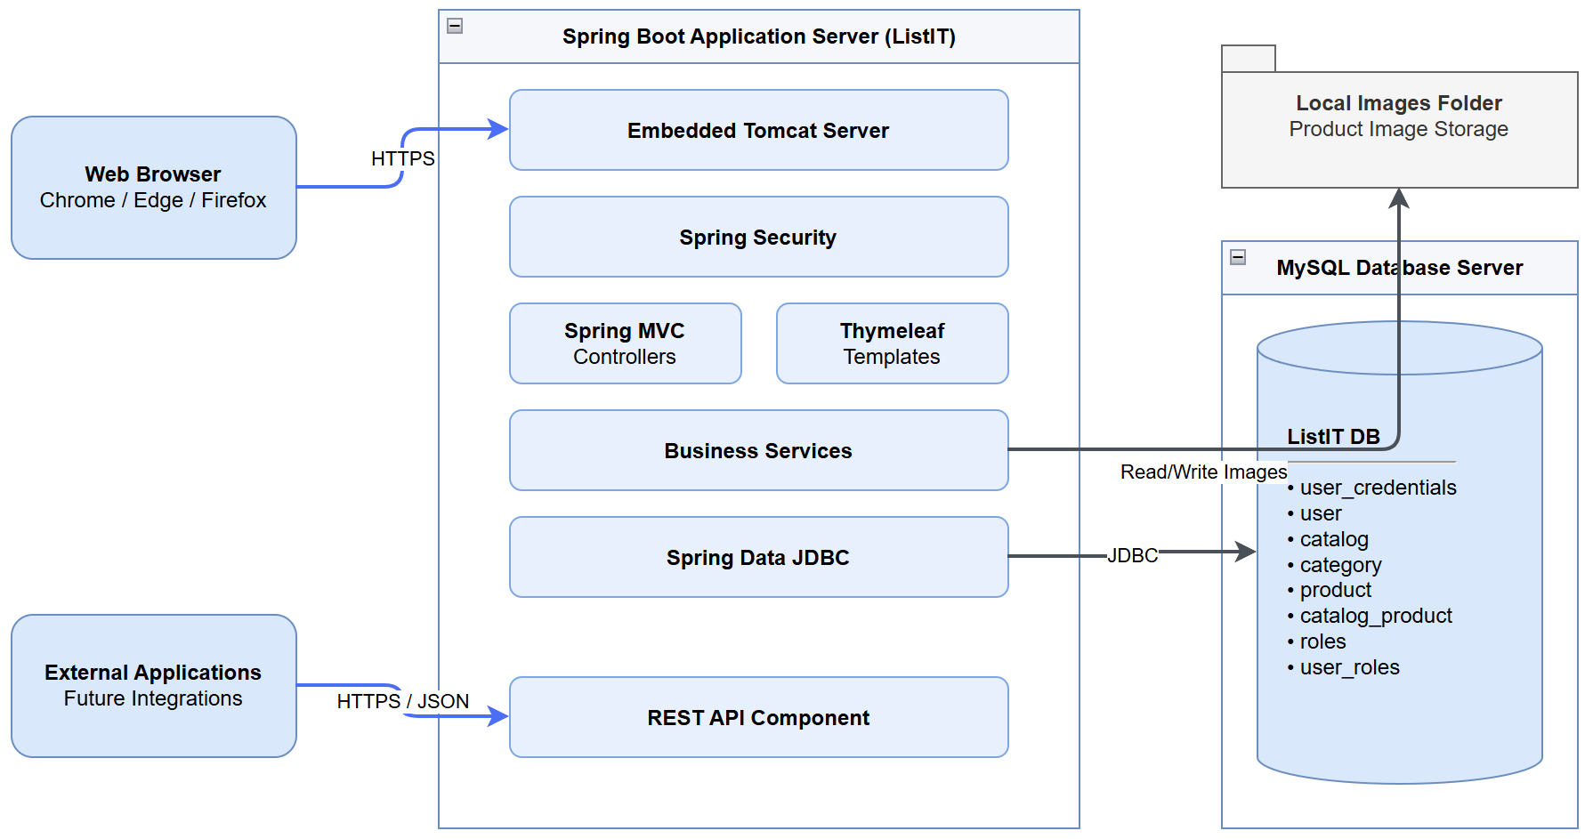
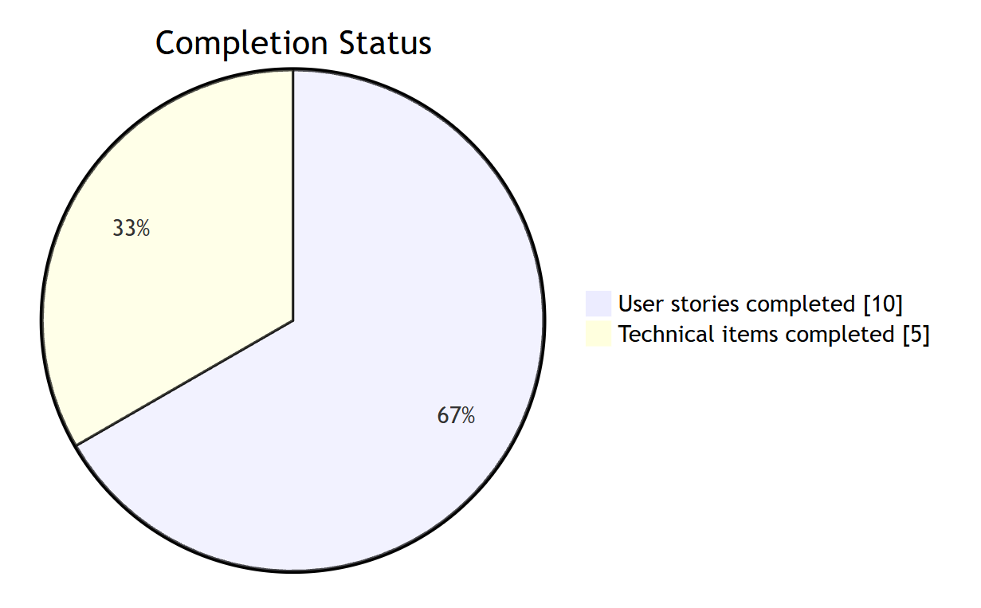
ListIT
Web-Based Inventory Management
Cody Crosby | GCU | CST-452
Project Overview
ListIT is a web-based inventory management system designed to proved users with a centralized platform for organizing and maintaining multiple inventory catalogs. Users can create catalogs, organize products into categories, and manage inventory records through a responsive web interface.
The project addresses the limitations of spreadsheets and manual inventory tracking, which can lead to disorganization, inconsistent data, and inefficient processes.
ListIT provides a structured solution while demonstrating full-stack software development practices.
Key Features
User registration & authentication
User profile management
Inventory catalog management
Parent/child category management
Product management
Catalog search & fitering
Catalog sharing
Administrative user management
Role-based authorization
Persistent application logging
Solution Design
ListIT uses a layered MVC architecture that separates presentation, business logic, and data access. Users requests are processed through Spring Boot controllers and services before data is persisted through Spring Data JDBC to a MySQL relational database. Spring Security provides authentication and role-based authorization.
Technology Stack
Layer | Technologies
Application | Java 17, Spring Boot 3.4.4
Web/UI | Thymeleaf, Bootstrap, HTML5, CSS3, JavaScript
Security | Spring Security, Bcrypt, HTTPS
Data | Spring Data JDBC, MySQL 8.0.44
Development | Spring Tool Suite 4, MySQL Workbench
Support | Custom CSV application logger
Physical Design Solution
Design & Development Process
Requirements > Architecure > Database/UI Design > Implemenation > Testing > Refinement
ListIT was developed incrementally, with features implemented and manually tested one at a time. Requirements, user stories, database design, wireframes, UML diagrams, and process flows were used to guide implementation. Testing and refinement continued throughout development.
Results/Relevant Data
User Stories Completed:
10/10
Technical Improvements Completed:
5/5

